Slide 1

Get off my lawn! AI is just pattern recognition.

Slide 2

Realistically there is a lot of promise.
Agentic workflows take us beyond the simple question-and-answer exchanges that have defined our initial forays into AI. Instead, they involve a cyclical process where AI systems continually refine their outputs, learn from interactions, and contribute more effectively over time
The next 24months will have “agentic” workflows, not bigger models.

Slide 3
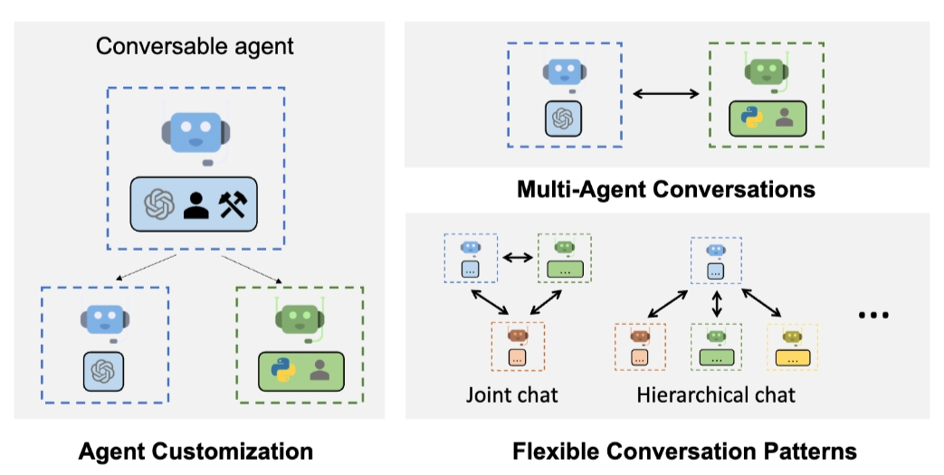
Problem solving agent workflows are emerging.
https://www.youtube.com/watch?v=sal78ACtGTc&ab_channel=SequoiaCapital

